Slide 1
WSC Quant
Intro to quant finance

Slide 2



Quantitative Finance a brief introduction
Quantitative finance merges finance, math, stats, and tech to enhance financial decision-making using data.
It is a combination of Computer Science, Finance and Mathematics (a lot of mathematics)
Quantitative Researchers are some of the highest paid professionals in the finance world.

Slide 3
Quantitative Finance a brief introduction
Quantitative trading, or algorithmic trading, involves using computer algorithms to make trading decisions. Traders design and program these algorithms to follow specific strategies. These strategies are created based on how well they performed when tested against past financial data. In essence, traders rely on these algorithms to automatically buy and sell securities, aiming to achieve consistent and profitable results based on historical trends and patterns.

Slide 4
Roles offered in Quantitative Finance
Quantitative Analyst (Quant): Develops and implements complex mathematical models for pricing, risk assessment, and trading strategies.
Quantitative Trader: Uses quantitative strategies to make trading decisions, often employing algorithmic trading.
Quantitative Portfolio Manager: Manages large investment portfolios using quantitative strategies

Slide 5
Most Famous Quant Trader and their companies
Edward Thorpe – Princeton-Newport Partners Gave 20% annualised returns for over two decades without a single year of drawdown
Jim Simons – Renaissance Technologies Corp.
The most fund i.e. Medallion Fund had a total return of 39% year-on-year since 1988-2019 and generated more than $100 billion dollars in return.

Slide 6
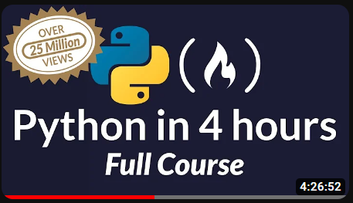
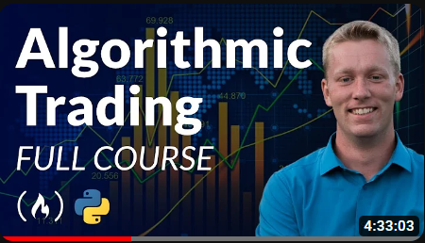
Some Good Resources for beginners.
Learn python : https://youtu.be/rfscVS0vtbw?si=3xg3xbji6ENCTuWt
Build basic Algorithmic trading projects: https://youtu.be/xfzGZB4HhEE?si=7sKTOR5ud_bpvuov

Slide 7
Let’s Get Started!

Slide 8
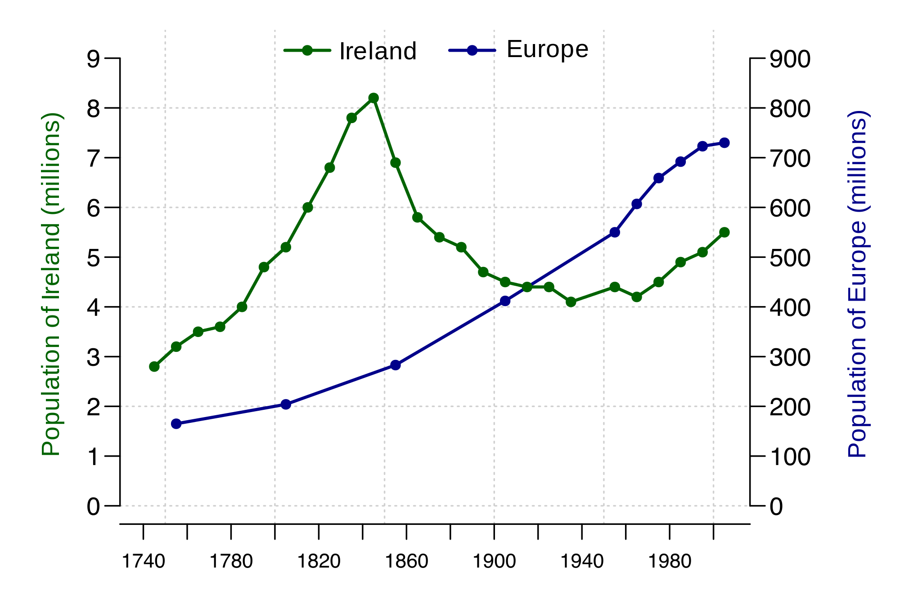
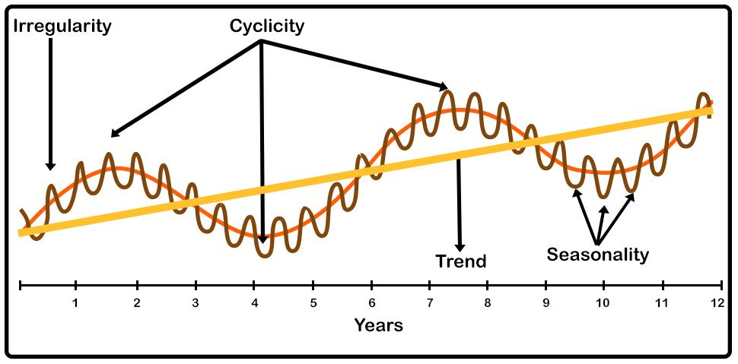
What is a time series?
In mathematics, a time series is a series of data points indexed in time order. Most commonly, a time series is a sequence taken at successive equally spaced points in time.

Slide 9

What is CAGR?
Compounded Annual Growth Rate:
CAGR lets you know the compounded returns you earn on an annual basis irrespective of the individual yearly performances of the fund.

Slide 10
Understanding returns and their superiority over prices:
Why do we use returns instead of prices?
A good way of normalizing the dataset.
For average investors, return of an asset is a complete and scale-free summary of the investment opportunity. Second, return series are easier to handle than price series because the former have more attractive statistical properties.

Slide 11
What are the types of Strategies used in Quantitive Finance ?
Arbitrage: Arbitrage is the simultaneous purchase and sale of an asset in different markets to exploit price differences and earn a profit.
Trend following:Trend following is a trading strategy that involves buying assets that are trending upwards and selling (or shorting) assets that are trending downwards, based on the idea that prices that are moving in one direction will continue to do so.
Mean reversion:Trend following is a trading strategy that involves buying assets that are trending upwards and selling (or shorting) assets that are trending downwards, based on the idea that prices that are moving in one direction will continue to do so.
Statistical Arbitrage:Statistical arbitrage is a trading strategy that uses statistical and mathematical models to identify and exploit price inefficiencies and mispricing in the market.

